Slide 1
Introduction to Python

Slide 2
Where are we?
High Level
Python
Middle Level Java/ C++
Low Level C
Assembly Code x86/x64/ARM
Machine Code Binary/Hex
CPU - Hardware

Slide 3
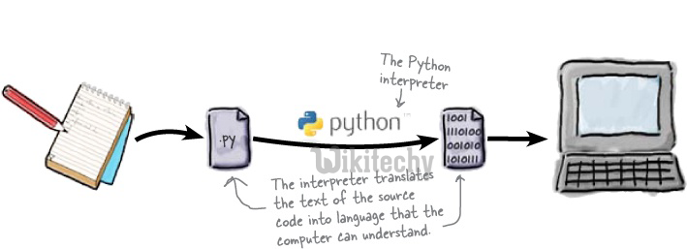
Source: https://www.wikitechy.com/tutorials/python/what-is-python

Slide 4
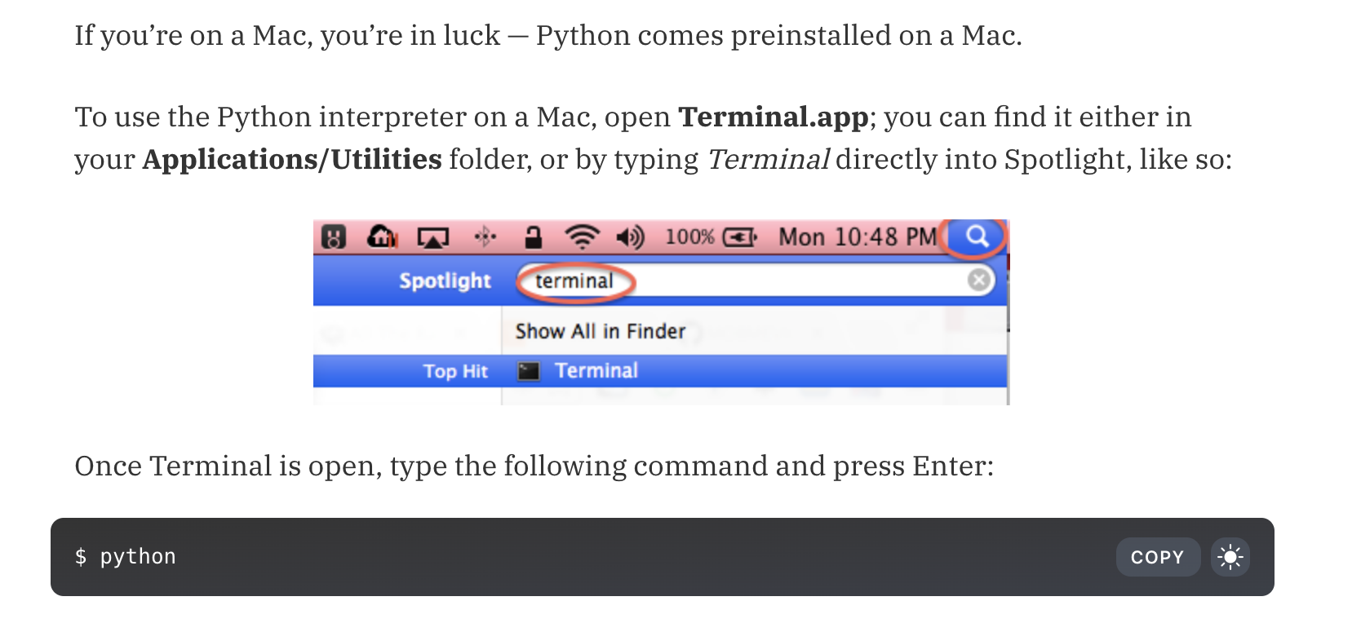
Getting Started - For Mac
python3

Slide 5
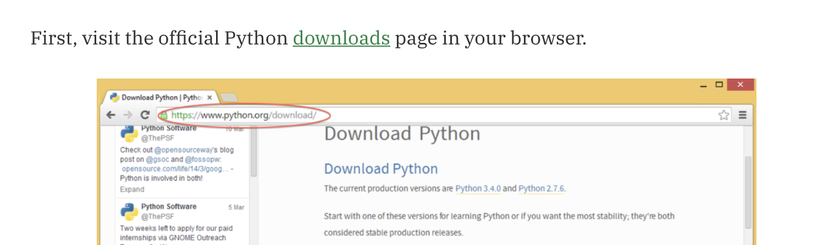
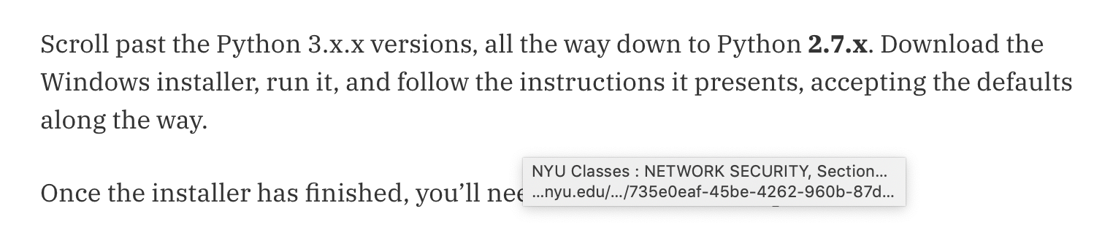
Getting Started - For Windows
Scroll to the python 3 versions.

Slide 6
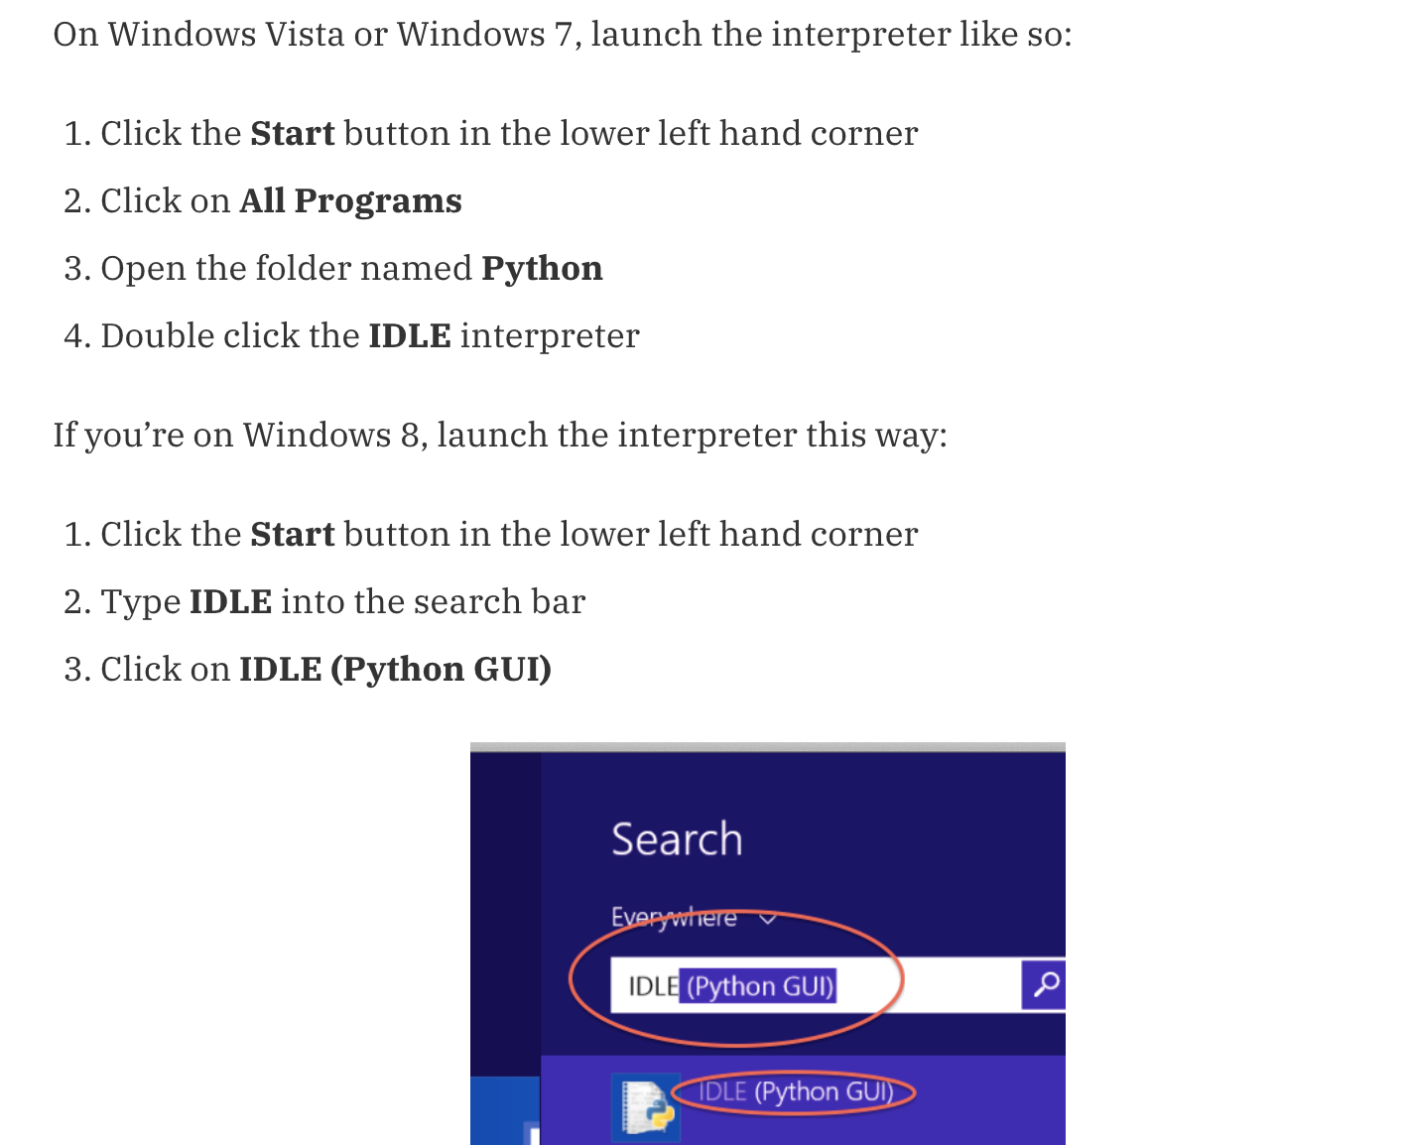
Windows Vista
Window 7 and 8

Slide 7
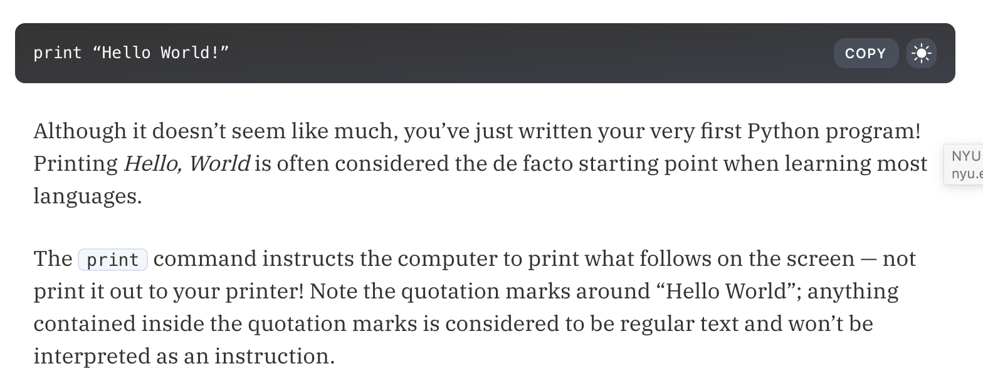
Print
(“Hello World!”)
Notes:
Credits: https://www.raywenderlich.com/2379-programming-for-teens-beginning-python-tutorial

Slide 8
Variables
A variable is a name that stores information.
The information stored by any variable is known as a value
Different types of variables store different types of values:
string - “Hello, students!”, “120abue*%\/;’a03”, “40 cows”
integer - 592039, 432, -67, 0
boolean - True/False
floats - 10.29, -23.4
Notes:
It’s like your variables in Algebra

Slide 9
Variables in Python - Assignment
A variable is assigned a value by using an equal sign.
ORDER MATTERS - The variable’s name must always be on the left of the equal sign, and the value must be on the right.
An example of an integer variable:
int_name = 27
An example of a string variable:
my_string = “You can put any sentence here”
Notes:
For simplicity’s sake we’ll focus on two types of variables for now - strings and integers

Slide 10
Properties of Integers
What is an integer?
Any whole number (can be negative)
You can apply most basic mathematical operations to integers.
Addition
Subtraction
Multiplication
Division

Slide 11
Printing Integer Variables
Printing - display something to the console
This is how you print integer variables:
File Editor | Console/Output
my_age = 18 print(my_age) | 18
Notes:
Show this on IDLE

Slide 12
Adding/Subtract Integer Variables
This is how you add or subtract integer variables:
File Editor | Console/Output
my_age = 18 time = 5 reverse = 10 my_age = my_age+time #OR my_age +=time print(my_age) my_age = my_age - reverse #OR my_age -= reverse print(my_age) | 23 13

Slide 13
Multiplying or Dividing Integer Variables
File Editor | Console/Output
num1 = 16 num2 = 4 product = num1*num2 quotient = num1/num2 print(product) print(quotient) | 64 4

Slide 14
Modulus and Integer Division Variables
% - Gives the remainder
// - Gives the whole number after the division
10 % 5 = 0 (0 is the remainder when 10 is divided by 5)
5 // 2 = 2 (2 is the whole number left after dividing 5 by 2)

Slide 15
Properties of Strings
What is a string? -- Basically any form of text.
To distinguish strings in Python, we use quotation marks
“This is a string” - double quotation marks
‘This is also a string’ - single quotation marks
Either method works
Strings can be indexed. (explanation later)
Strings have lengths - this is the number of characters and whitespaces between the quotation marks.

Slide 16
Properties of Strings - Printing
File Editor | Console/ Output
string1 = “Hello, world” print (string1)

Slide 17
Properties of Strings - Printing
File Editor | Console/ Output
string1 = “Hello, world” print (string1) | Hello, world
Notes:
Mention commenting

Slide 18
String Indexing
Strings in Python have a method that you can use to access specific characters in the string.
For instance, the string, unknown = “Did Solo shoot first?”
You can access specific characters- for instance the “S” in “Solo” - in the string by doing:
unknown[4] #if you print this, the output will be “S”
D | i | d |  | S | o | l | o |  | s | h | o | o | t |  | f | i | r | s | t | ?
0 | 1 | 2 | 3 | 4 | 5 | 6 | 7 | 8 | 9 | 10 | 11 | 12 | 13 | 14 | 15 | 16 | 17 | 18 | 19 | 20

Slide 19
String “find()” method
What if you’re looking for a specific phrase or character inside a string?
Use the find() method:
string_name.find(“any phrase”, start_index, end_index)
This method returns an index if it is found, and -1 if it is not found
File Editor | Console/Output
unknown = “Did Solo shoot first?” #looking for shoot location = unknown.find(“shoot”) print(location) | 9
Notes:
string.count()- used to count phrases or characters in a string.

Slide 20
String Length
You can get the number of characters in a string (including whitespace) using the “len” function - len(string_name)
Using the previous string, unknown:
The len function returns an integer type variable.
File editor | Console
length = len(unknown) print(length) | 21

Slide 21
Adding Strings
You can add any number of strings together using the + operator
This concatenates the strings
Ex:
string1 = “Hello”
string2 = “ World”
print(string1+string2) #will print out Hello World

Slide 22
Printing with Different Types of Variables
You know how to print strings and integers separately, but what if you want to print them all in one line?
Example Output:
There are 24 laptops in this room and 27 people.
Notes:
Concatenate

Slide 23
Getting User Input
In all of our previous examples we - the programmers - have been assigning values to our own values.
Getting user input is simple:

Slide 24
Getting User Input
In all of our previous examples we - the programmers - have been assigning values to our own variables.
Getting user input is simple:
File Editor | Console/ Output
yourname= input(“enter your name”) #this assigns the name to yourname print (yourname) #prints your name | Enter your name: Parina Parina

Slide 25
Getting User Input (con’td)
Be aware of variable types!
When using the input function, all variables are automatically string type.
File Editor | Console
age= input(“Enter an age”) # age variable is still a string type # age= 7 will give you an error age = int(input(“Enter an age”))

Slide 26
Converting between types
Int to String:
str(thisVariableGetsConverted)
String to Int:
int(thisVariableGetsConverted)

Slide 27
Logical Operations!
Logical operators are mainly used to control program flow.
Usually, you will find them as part of an if, a while, or some other control statement.
The three logical operators we are doing today are:
AND , OR , NOT

Slide 28
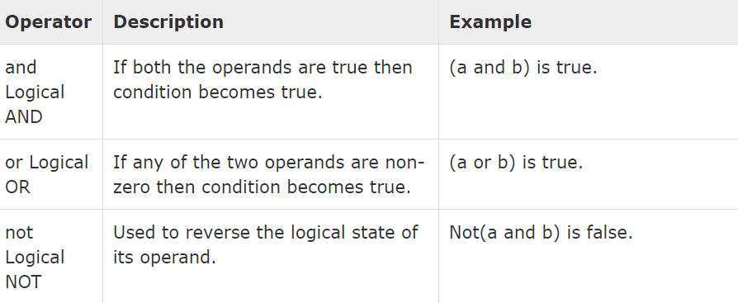
THESE OPERATIONS IN PYTHON !
NOW LET US SEE SOME EXAMPLES !

Slide 29
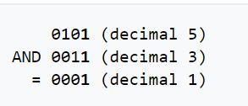
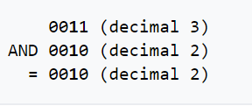
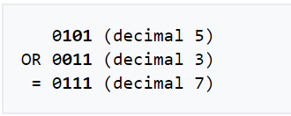
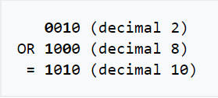

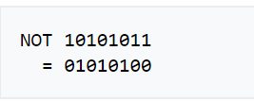

Slide 30
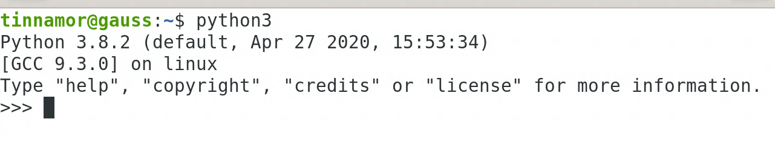
Recap
Variables hold a value. Four types of variables for now - string, integer, float, boolean
Integer variables can be added, subtracted, multiplied, and divided
String variables are indexed by character.
specific characters can be accessed using square brackets String_name[index]
find() method - string_name.find(“phrase”, startdex, endex)
len() function - len(string_name)
To print integer and string variables in one statement, separate each variable with commas.
Get user input using the input() function, which returns a string.
Interpreter: running python3 in command line will bring up the interpreter (denoted by >>>)
This is where you can immediately execute python commands and looks like the image below

Slide 31
Practice Problem 1-5
Problem 1: Enter the string say- “Flnbobtklbobstmbob”
Print the number of times the substring “bob” appears in the main string
and also print bob along with it.
Sample output= 3, bob
Problem 2: Reverse a string using python indexing.
Hint: (negative indices can be used)

Slide 32
Problem 3:
Enter a 4 digit number
Calculate the sum of all the digits of that number.
Eg - Input : 1234 , Output- 10

Slide 33
Problem 4: Enter a string and count the number of occurrences of each character in the string and print it.
Input : “assassination”
Output:
a -----> 3
s -----> 4
i ------> 2
n ------> 2
t------> 1

Slide 34
Problem 5: Enter a string and print only the vowels :
Entered String: “Titash”
Output - a i

